Slide 1

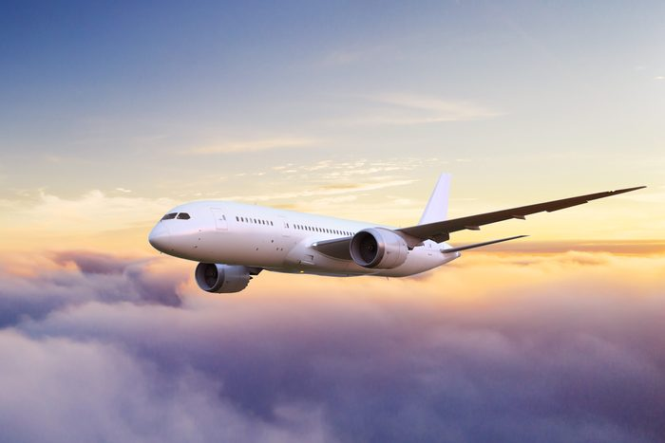
Airline Passenger Satisfaction
Lauren Sweeney
Springboard – DSC
Capstone Project #2

Slide 2

Problem Statement
Our client, Super Important Airline (”SIA”), wants to increase revenue
SIA’s board of directors has requested that we analyze survey data from their airline passengers. Their question:
What separates SIA’s “satisfied” airline passengers from their “neutral or dissatisfied” passengers?
Dataset was procured from SIA’s passenger survey, which included data from over 120,000 airline passengers
We determined which variables were most important for passenger satisfaction by calculating the highest Accuracy, Precision, & Recall scores by building machine learning models

Slide 3
Dataset Variables – Qualitative & Continuous
Variable Name | Information re Variable
Gender | Male | Female
Customer Type | First-Time | Returning
Type of Travel | Business | Personal
Class | Business | Economy | Economy Plus
Age | Numerical ranging from 7 to 85
Flight Distance | Numerical
Departure Delay | Numerical
Arrival Delay | Numerical

Slide 4
Dataset Variables – Passenger Survey Questions
Variable Name | Information re Variable
Departure & Arrival Time Convenience | Numerical ranging between 0 & 5
Ease of Online Booking | Numerical ranging between 0 & 5
Check-In Service | Numerical ranging between 0 & 5
Online Boarding | Numerical ranging between 0 & 5
Gate Location | Numerical ranging between 0 & 5
On-Board Service | Numerical ranging between 0 & 5
Seat Comfort | Numerical ranging between 0 & 5
Leg Room Service | Numerical ranging between 0 & 5
Cleanliness | Numerical ranging between 0 & 5
Food & Drink | Numerical ranging between 0 & 5
In-Flight Service | Numerical ranging between 0 & 5
In-Flight WIFI Service | Numerical ranging between 0 & 5
In-Flight Entertainment | Numerical ranging between 0 & 5
Baggage Handling | Numerical ranging between 0 & 5

Slide 5

Determining Project Success & Constraints
Success:
Determining which variables impact the satisfaction of passengers the most
SIA can best tolerate False Negatives than False Positives, therefore, we needed to determine which model had the highest precision
Constraints:
SIA’s competitors were not surveyed
Costs of implementation not available

Slide 6
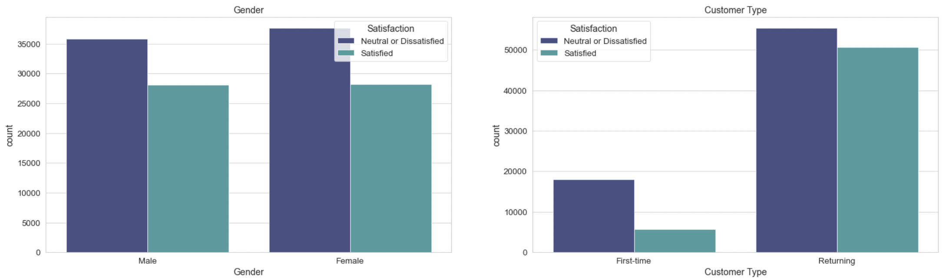
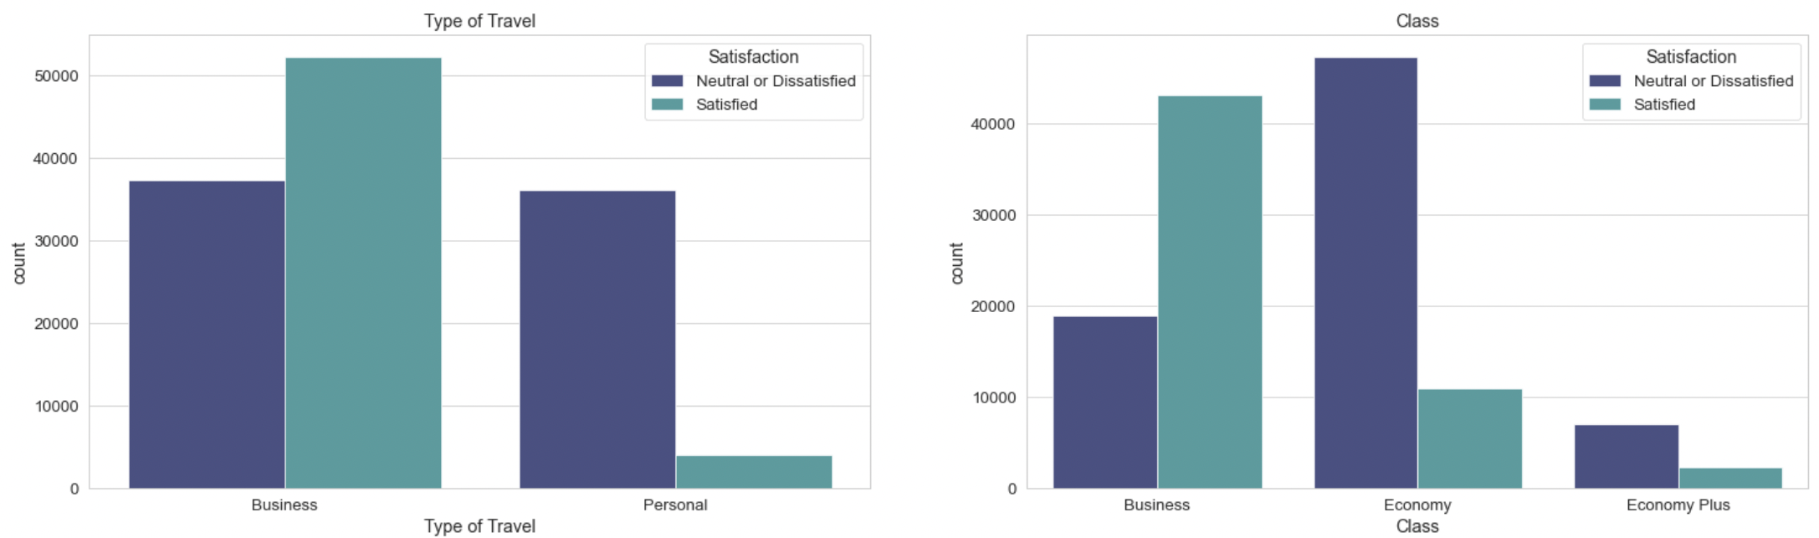
Exploratory Data Analysis

Slide 7
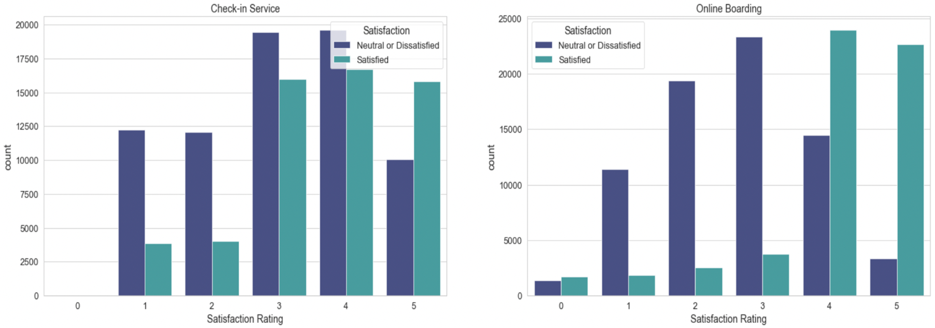
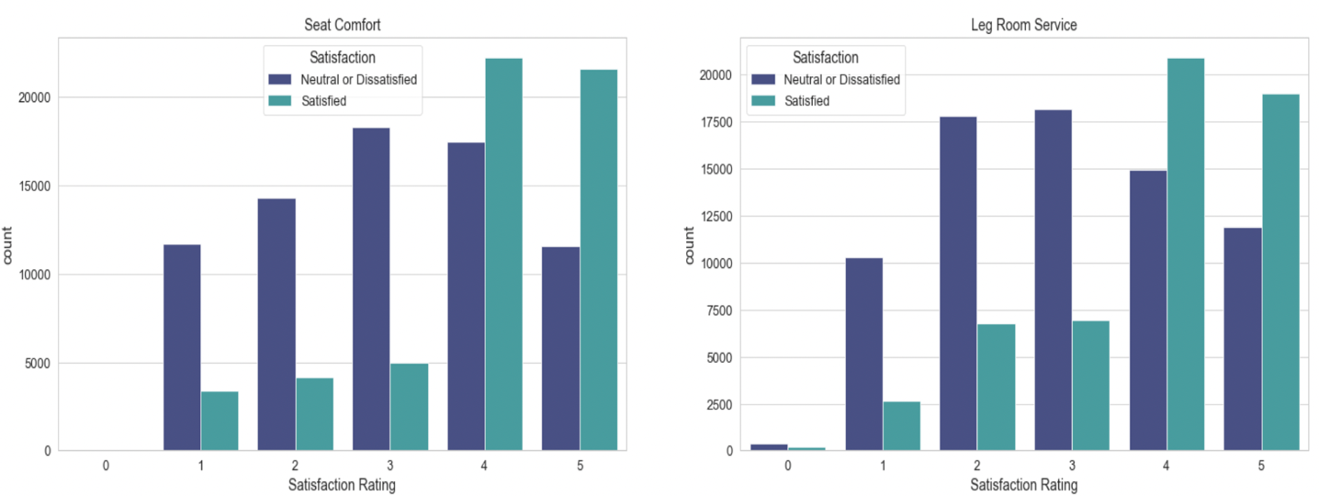
Exploratory Data Analysis

Slide 8
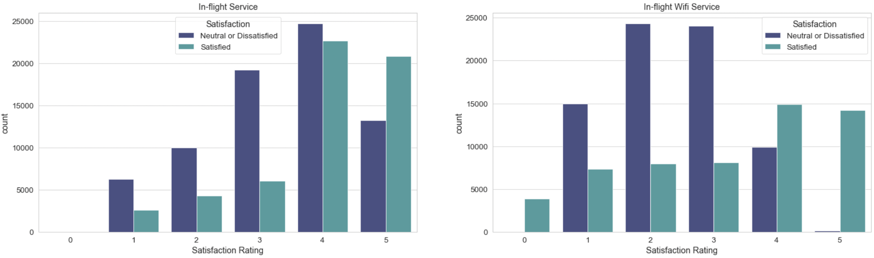
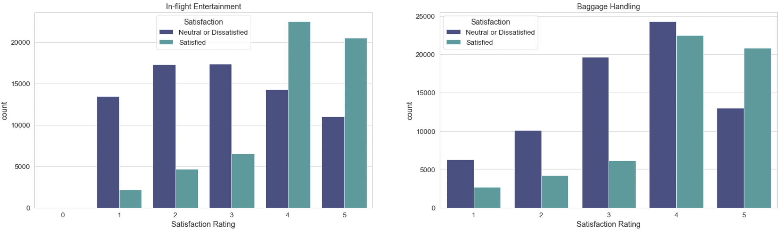
Exploratory Data Analysis

Slide 9
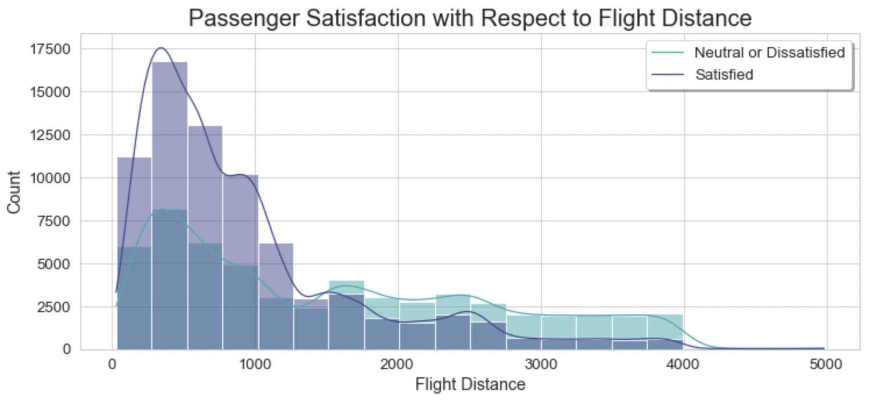
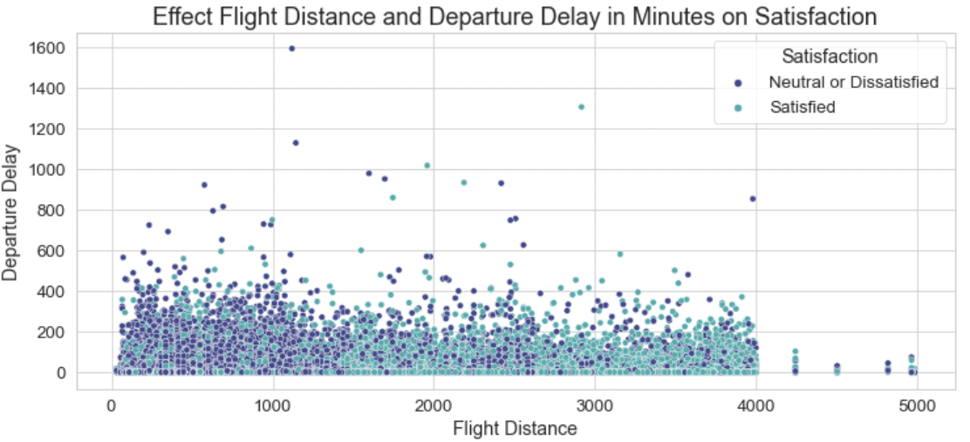
Exploratory Data Analysis

Slide 10
Model Selection
Model | Test Precision | Test Recall | Test F1-Score
Logistic Regression – RUS | 0.68 | 0.58 | 0.63
Logistic Regression – SMOTE | 0.68 | 0.59 | 0.63
Random Forest – RUS | 0.97 | 0.96 | 0.97
Random Forest – SMOTE | 0.96 | 0.98 | 0.97
In total, we created 4 models:
Logistic Regression using random under sampling
Logistic Regression using SMOTE
Random Forest using random under sampling
Random Forest using SMOTE
We performed hyperparameter tuning on the Random Forest models, which did not change their performance metrics.
The Random Forest model using random under sampling still slightly outperformed the Random Forest model using SMOTE
As a result, we determined that the best model for the needs of our client was the Random Forest model using random under sampling, due to its test precision of 0.97

Slide 11
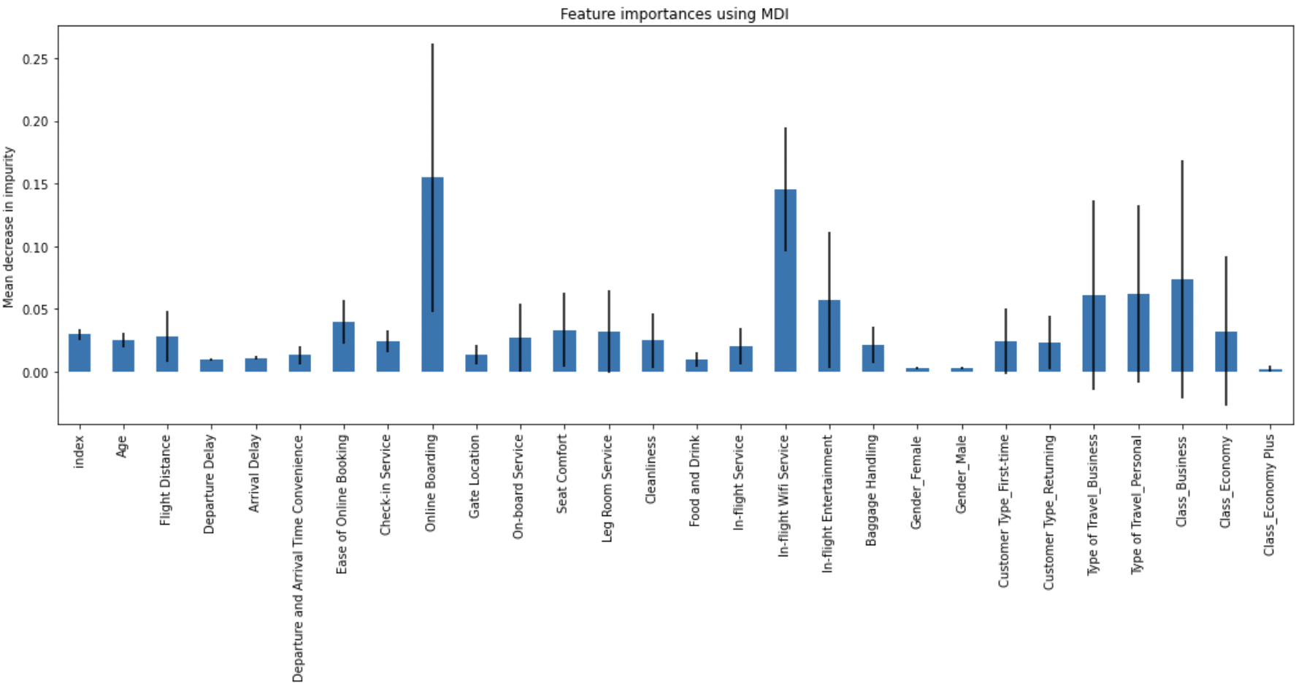
Feature Importances
Since we identified the best model for our client, we were then able to use that model to determine which features were the most important to the overall satisfaction of passengers
The most important features:
Online Boarding
In-Flight WIFI Service
Class_Business
Type of Travel_Personal
Type of Travel_Business
In-Flight Entertainment
Ease of Online Booking
Seat Comfort
Class_Economy
Leg Room Service

Slide 12
Conclusions & Recommendations
What did we learn during exploratory data analysis?
What did we learn after building machine learning models?
Recommendations for the future:
Perform similar analysis on competitors to determine whether there are differences in passenger satisfaction
After enacting changes, perform analysis on a future passenger survey to determine whether those changes increased overall passenger satisfaction
SIA should consider enacting changes to features that performed poorly

Slide 13
Thank You!

